Slide 1
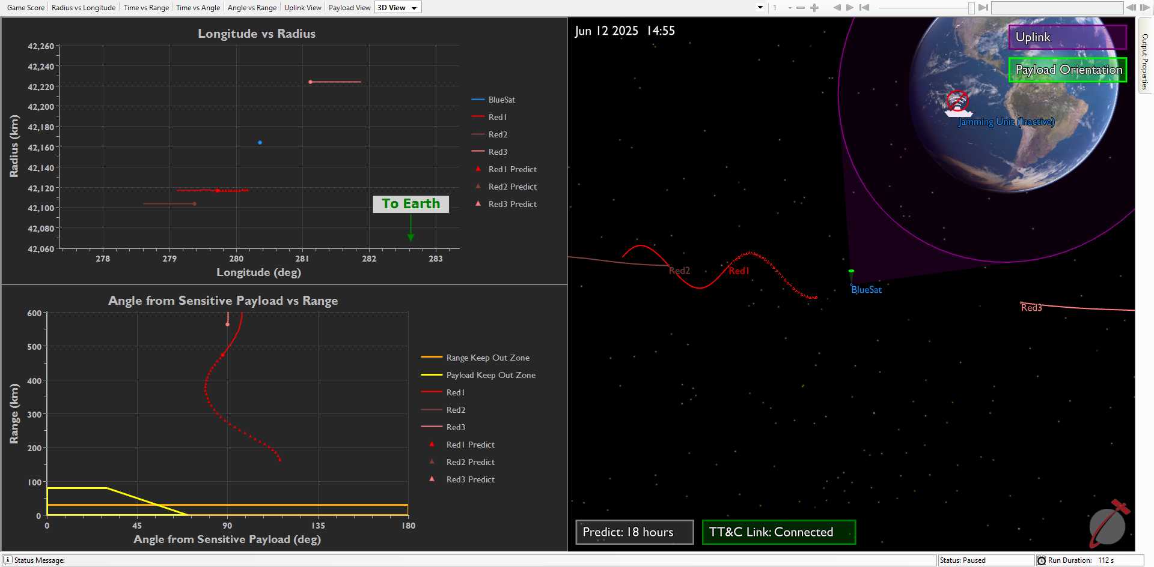
1
2
4
3

Slide 2
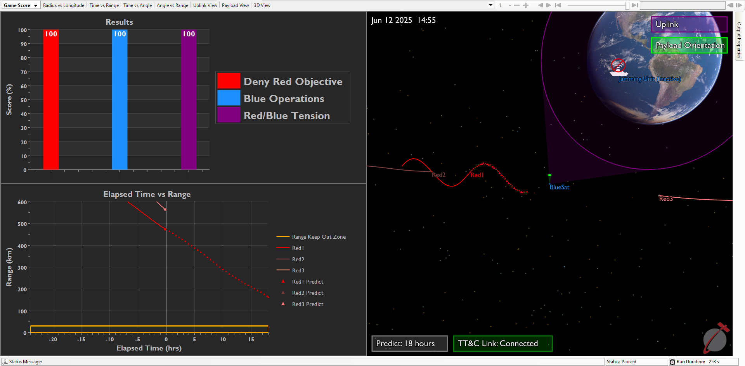
11
5
6
7
8
9
10

Slide 3
Payload
θ

